Slide 1
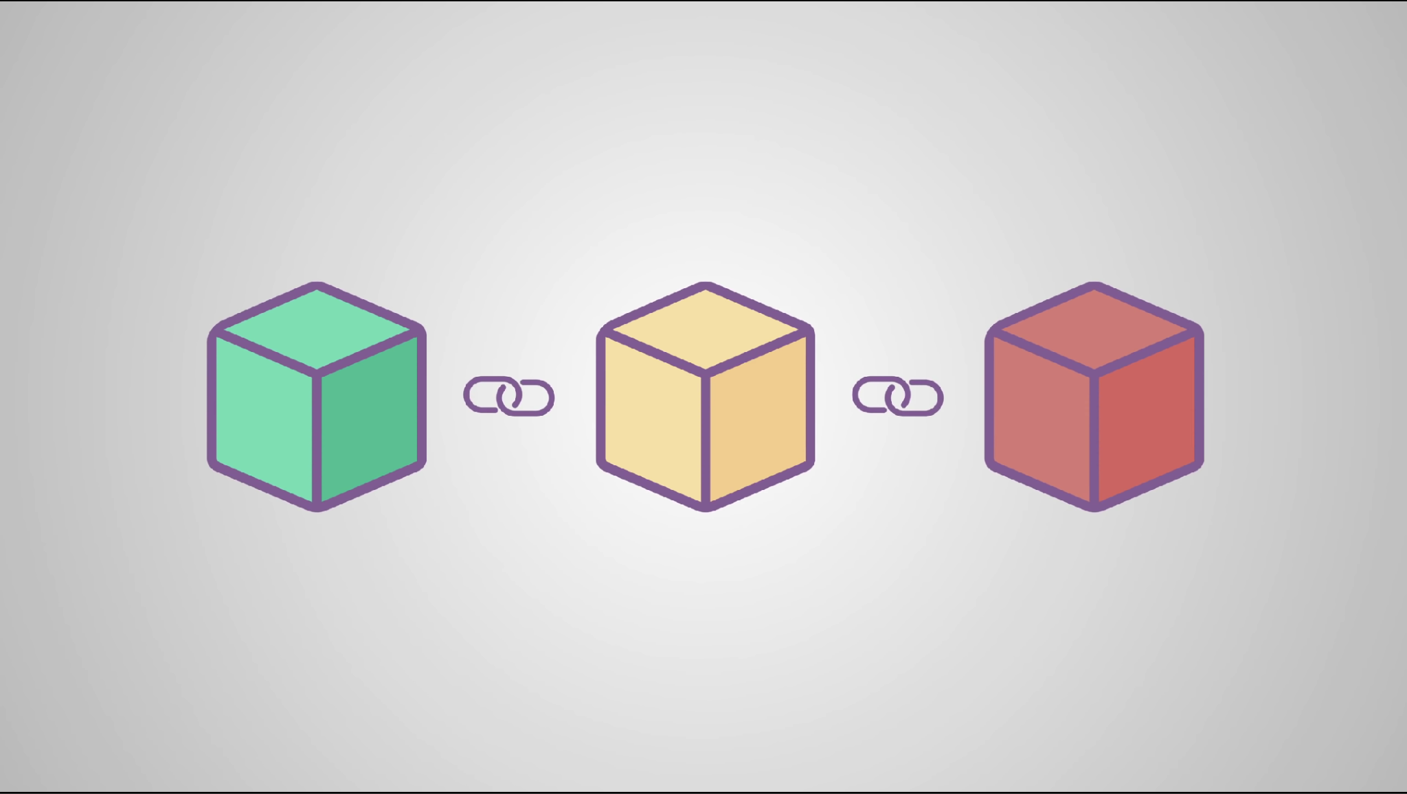
Blockchain
Hideg Paul

Slide 2
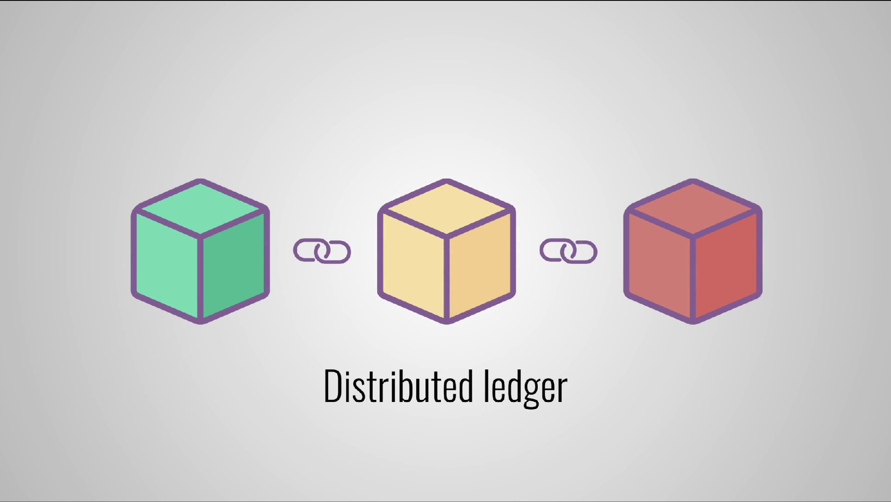

Slide 3
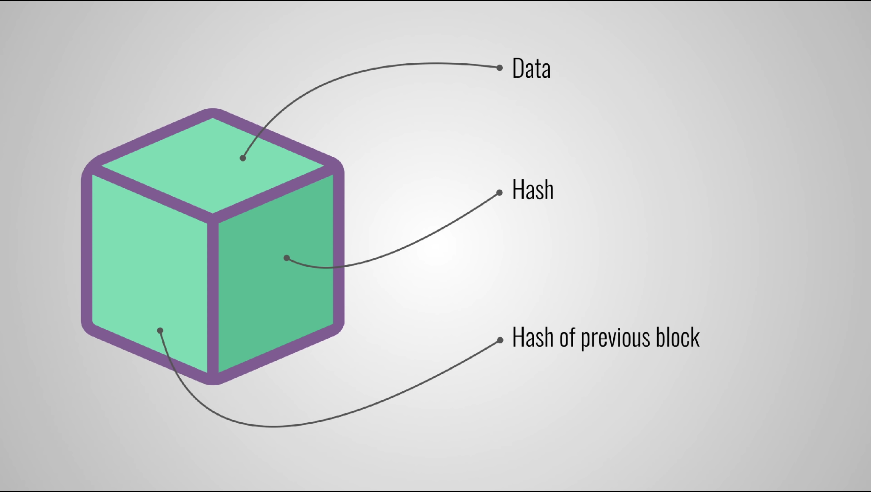
From: A
To: B
Amount: 10
7196759210defdc0
519cf56610dz1dc0

Slide 4
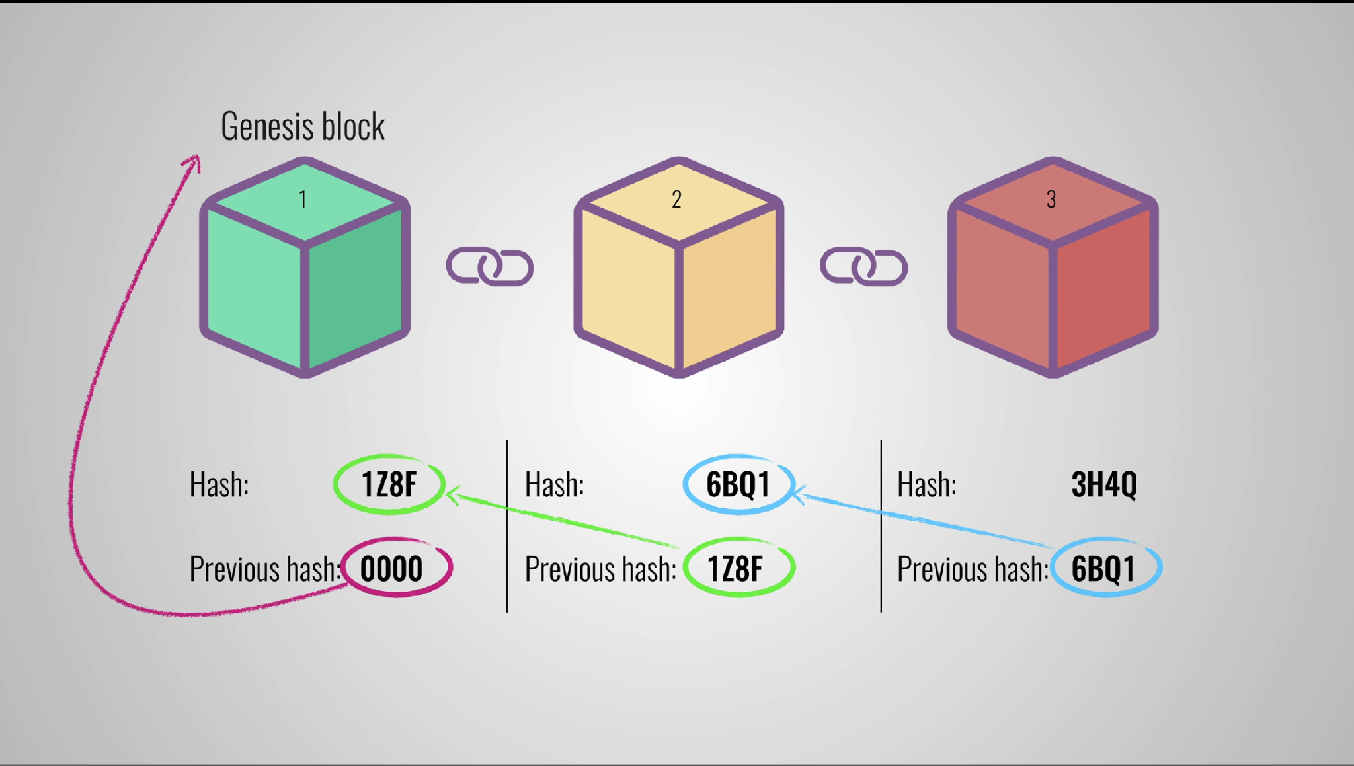

Slide 5
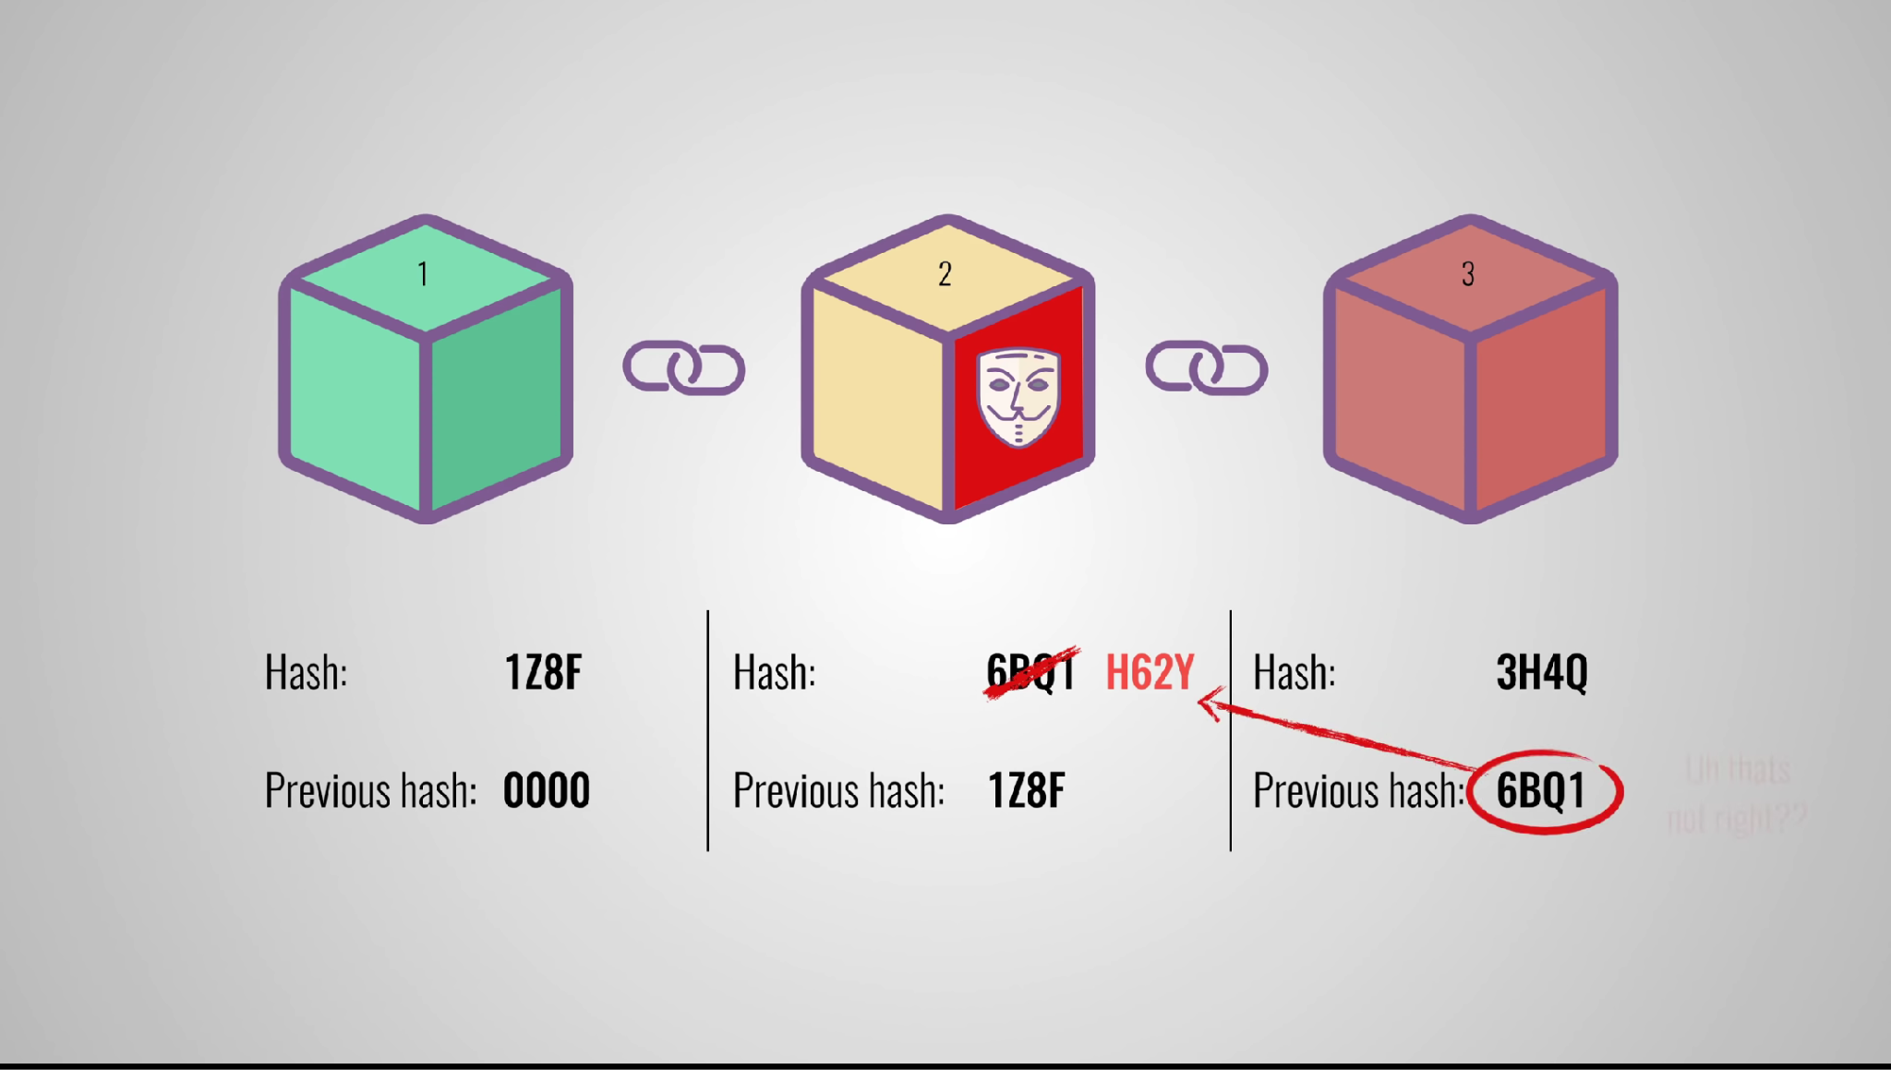

Slide 6
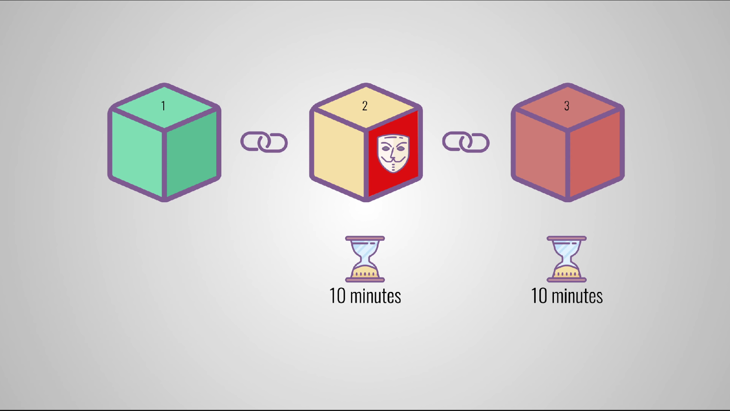
Proof of work

Slide 7
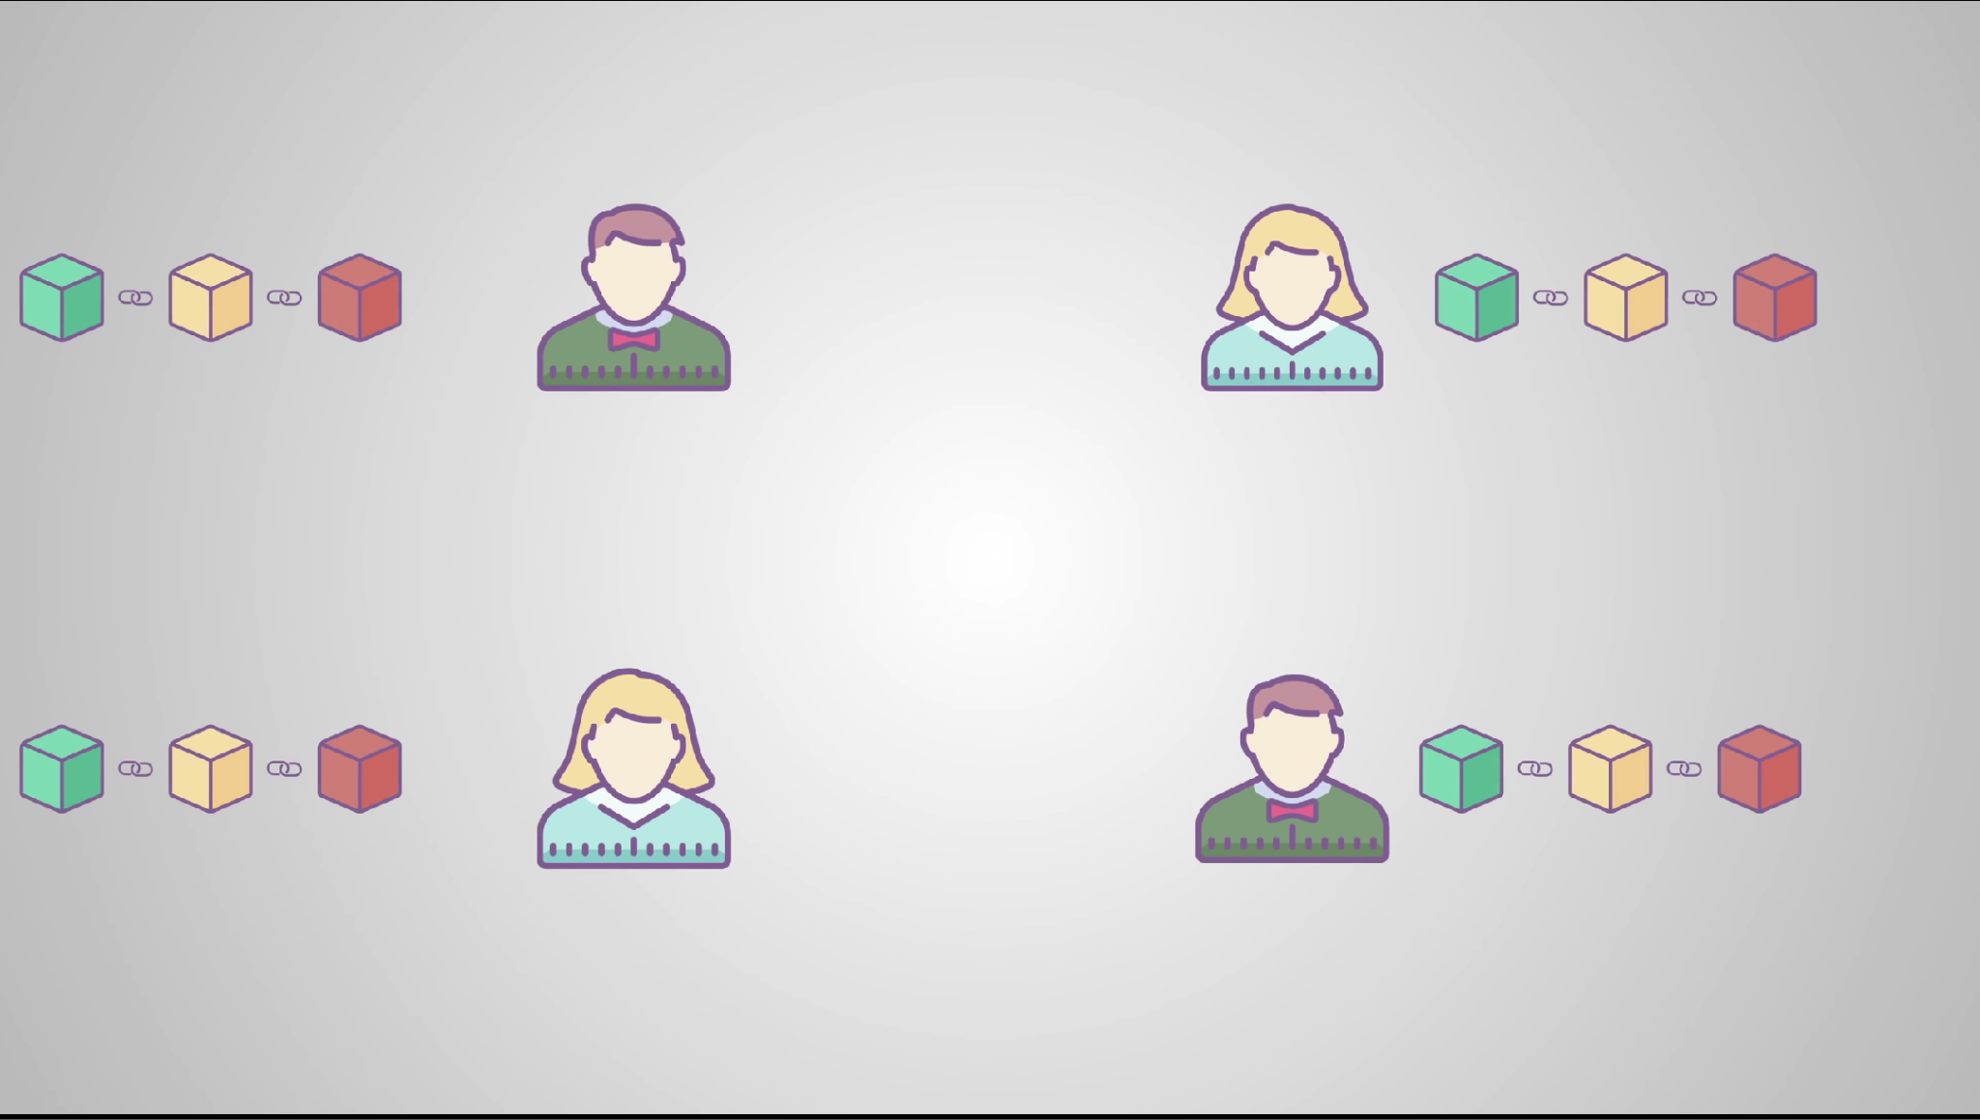
P2P Network

Slide 8
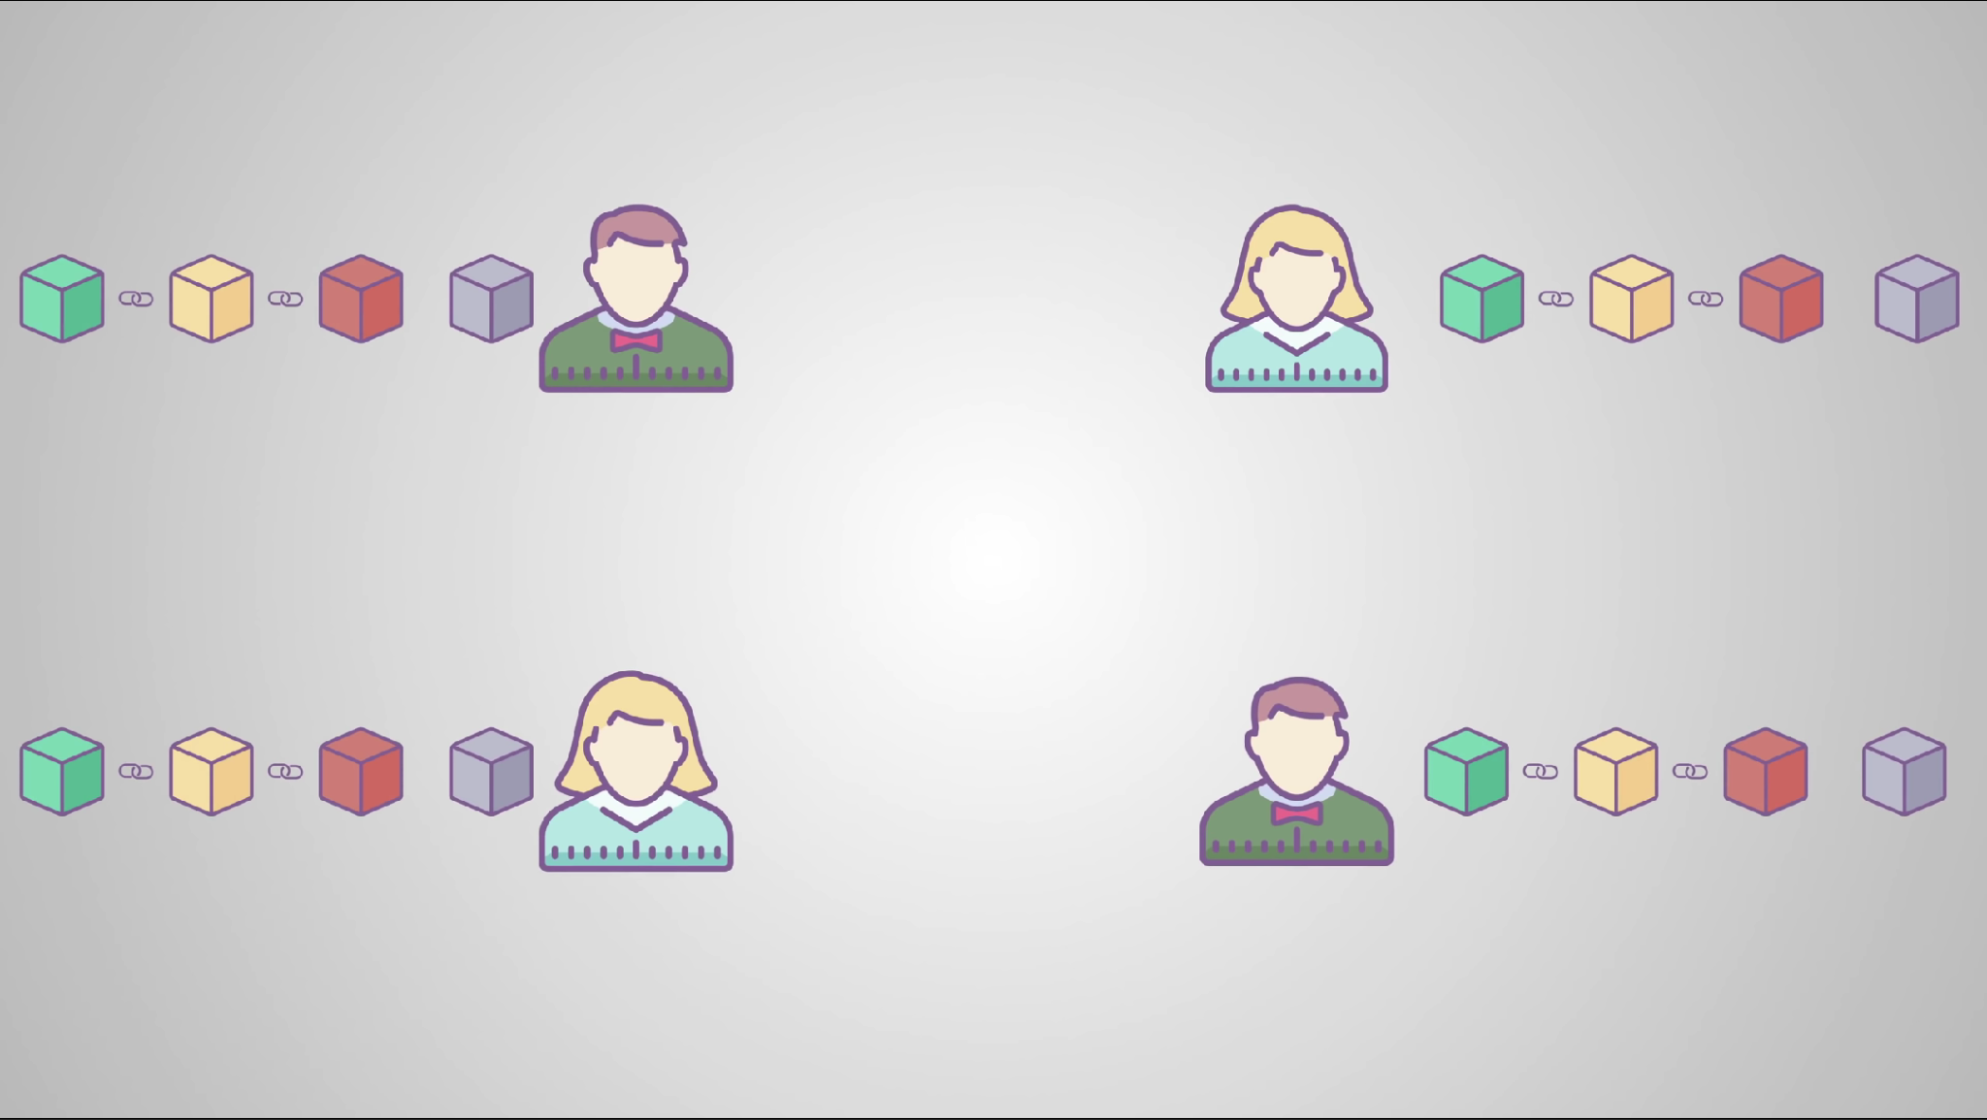


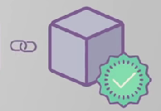
New block

Slide 9
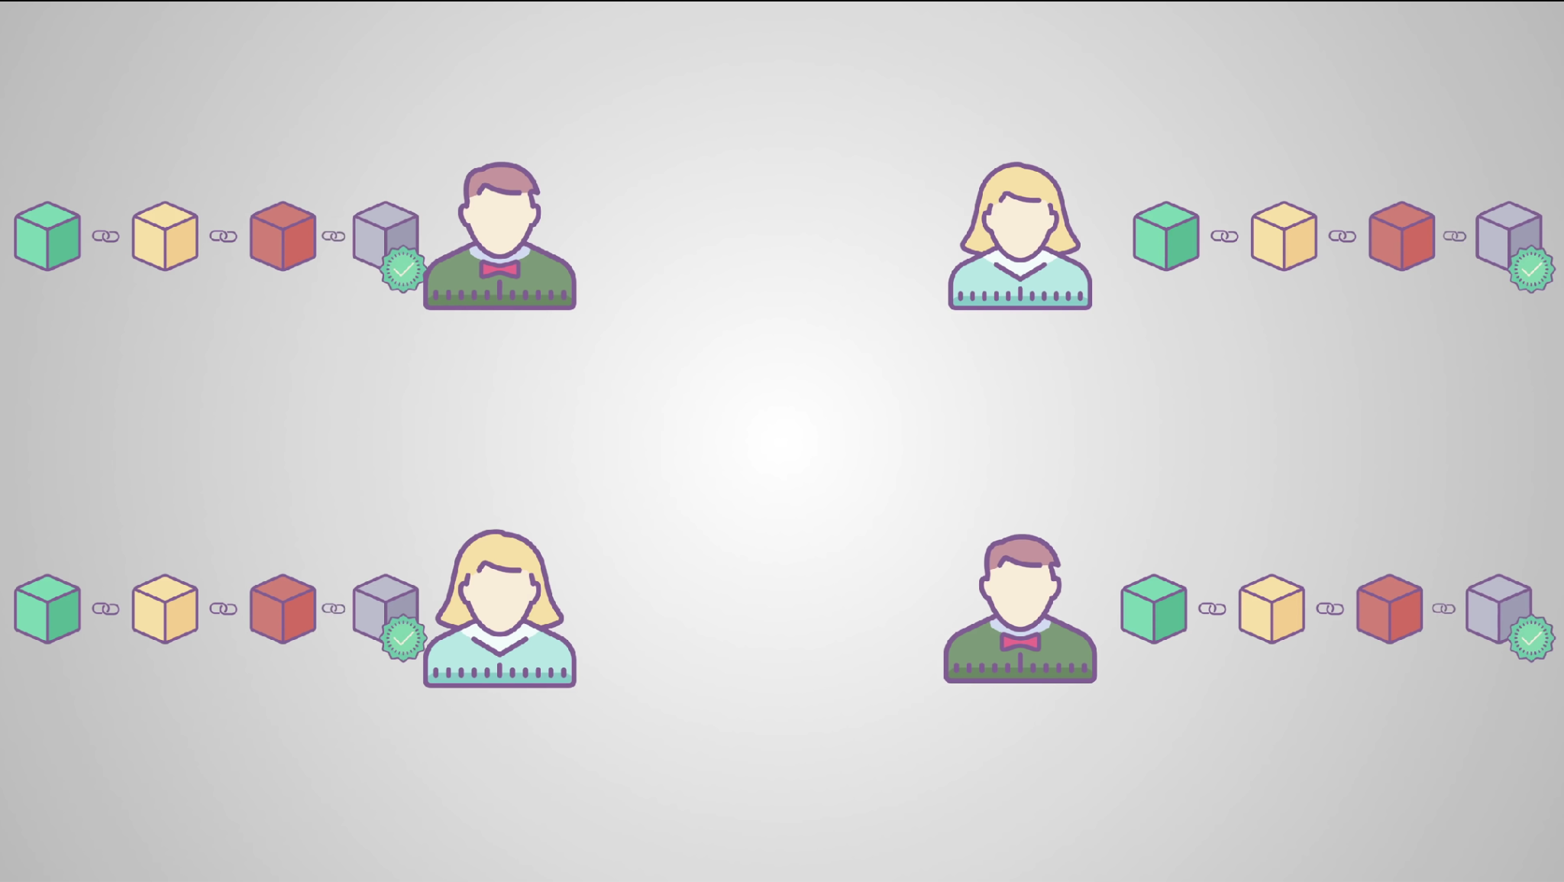

Slide 10


Slide 11
Blockchain demo at:
Blockchain Demo
Bibliography:
https://doi.org/10.1007/BF00196791
https://bitcoin.org/bitcoin.pdf
https://hbr.org/2017/01/the-truth-about-blockchain

Slide 12
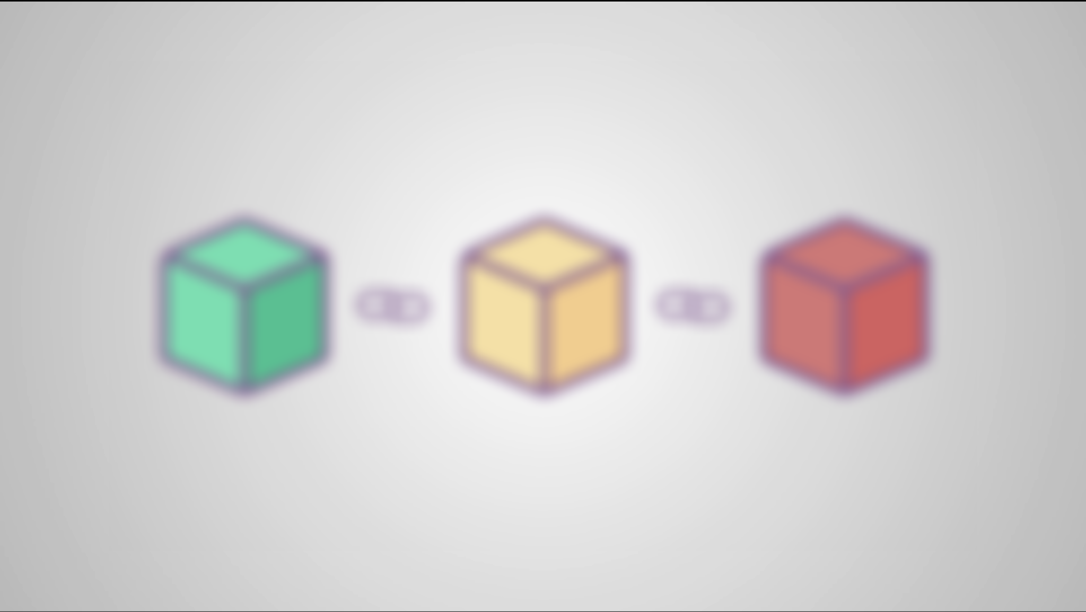
Thank you
Thank you!

